Slide 1
Antenna Labor Forecast Meeting
Akash Iyer
Data Science Intern
July 11th, 2024

Slide 2
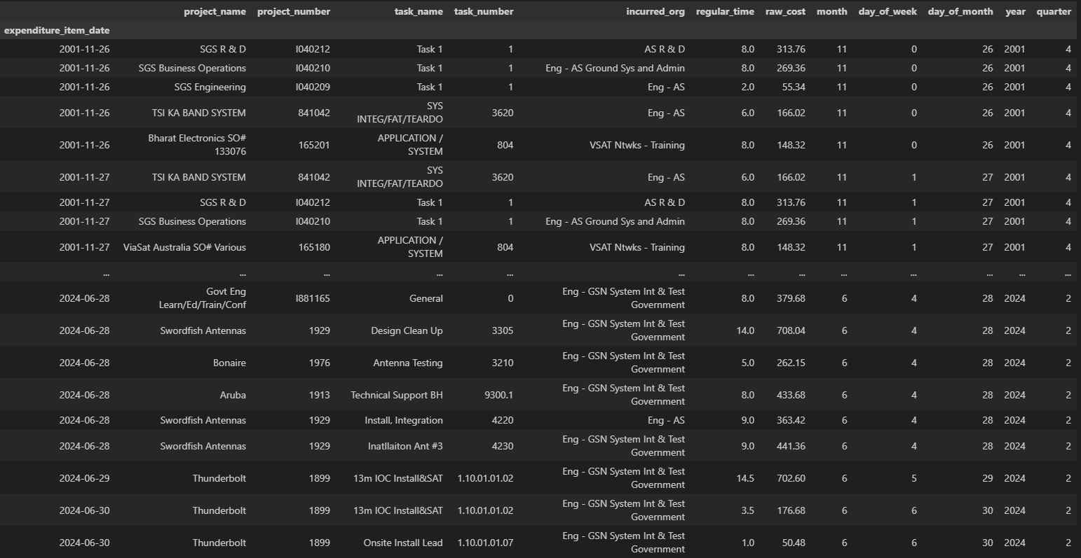
The new dataset we are working with:
Notes:
86k rows, 2001-2024
TODO: Ensure with Sarah if any of these tasks should be included.

Slide 3
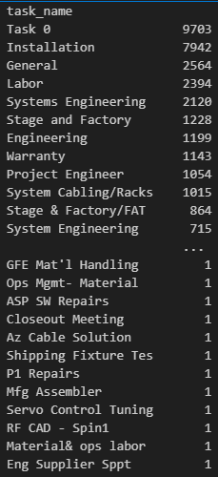
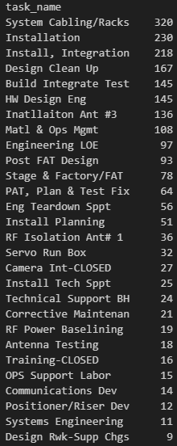
Tasks are still plentiful, however seem much more “focused.”
All expenditures
Swordfish
Notes:
TODO: Ensure with Sarah if any of these tasks should be included.

Slide 4
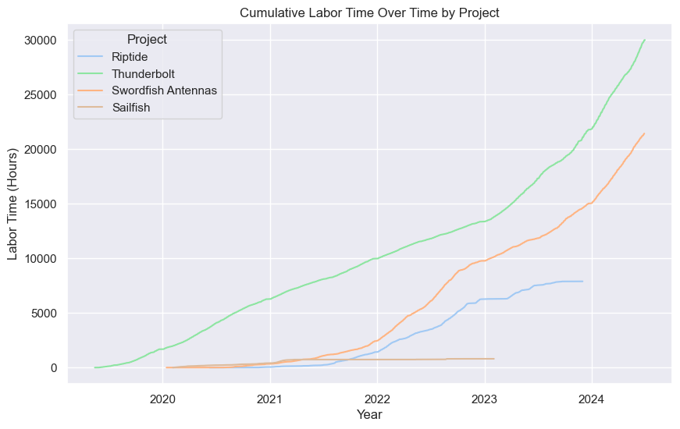
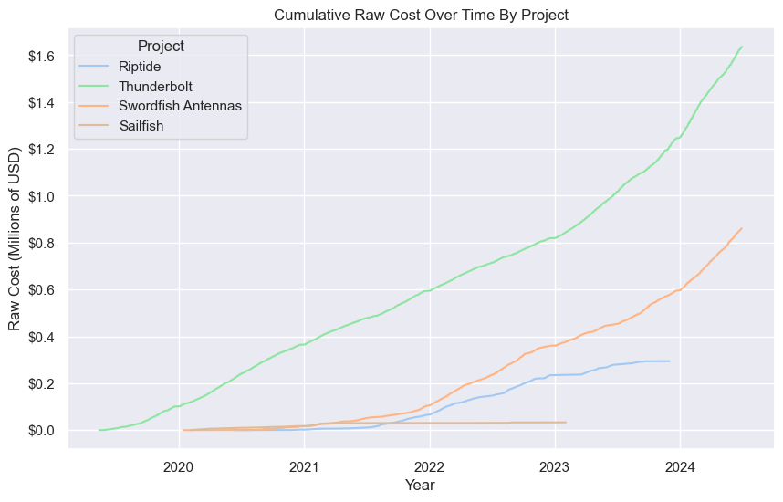
Cumulative Time and Cost by Program

Slide 5
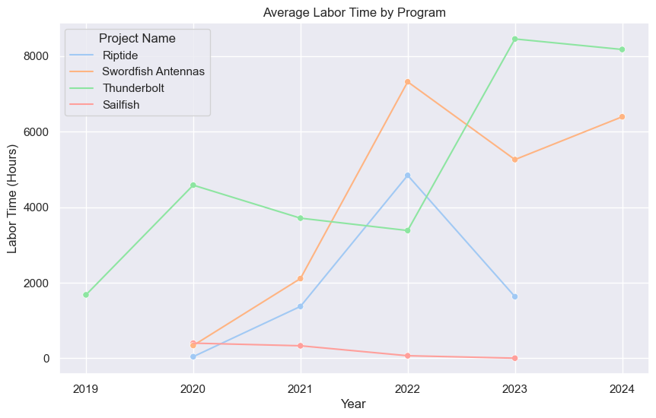
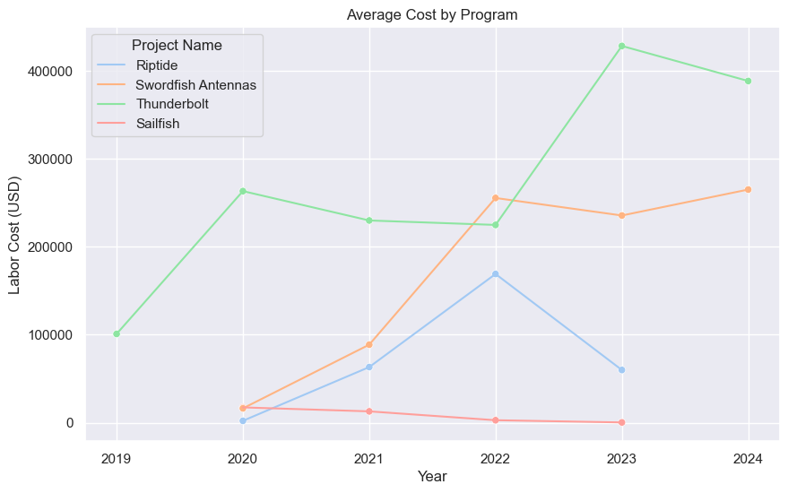
Yearly Time and Cost by Program
Notes:
Each point on the graph can be read as “In the year ____, project ____ had $_____ in labor expenditures.” or “In the year ____, project ____ spent _____ hours working.”

Slide 6
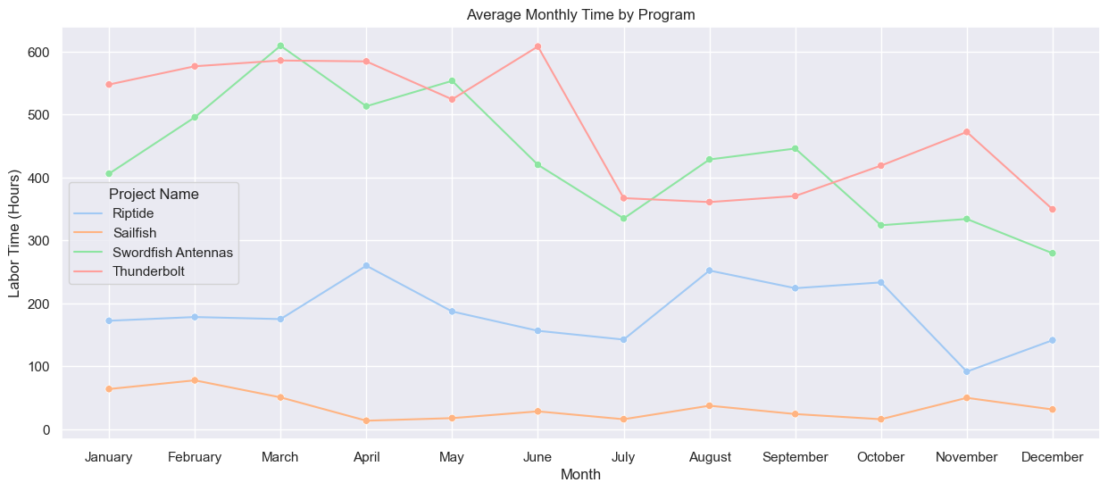
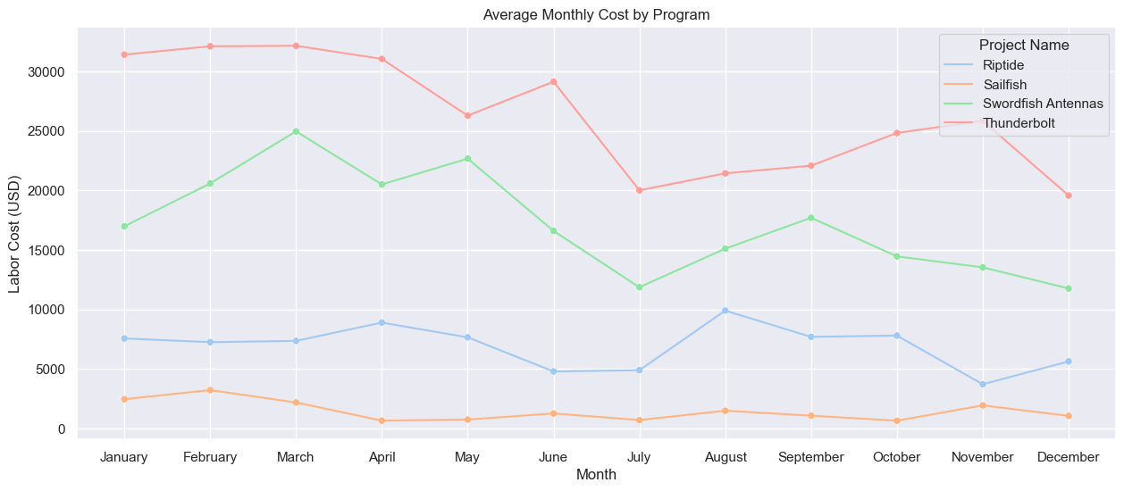
Average Monthly Time and Cost by Program
Notes:
Read like: “The average time worked in the month ____ across all years for project ____ was ____.”

Slide 7
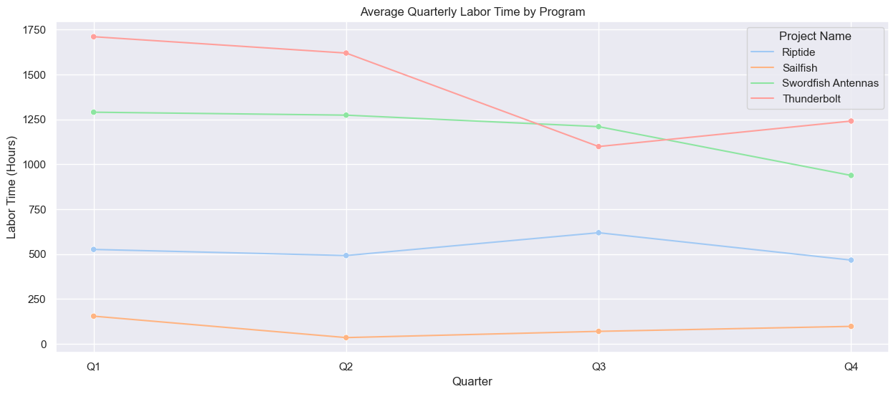
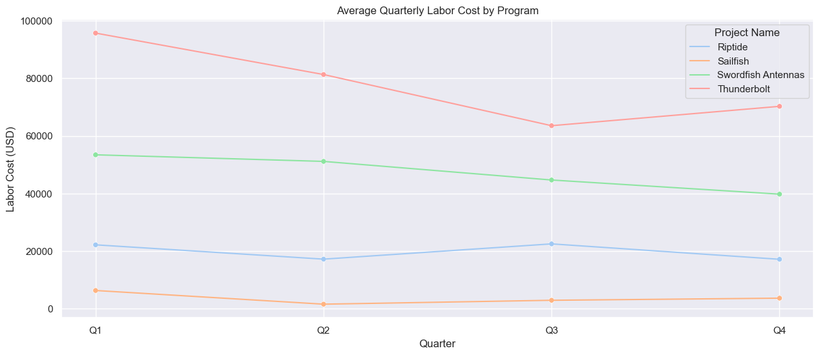
Average Quarterly Time and Cost by Program
Notes:
Read like: “The average time worked in quarter __ across all years for project ____ was ____.”

